Slide 1

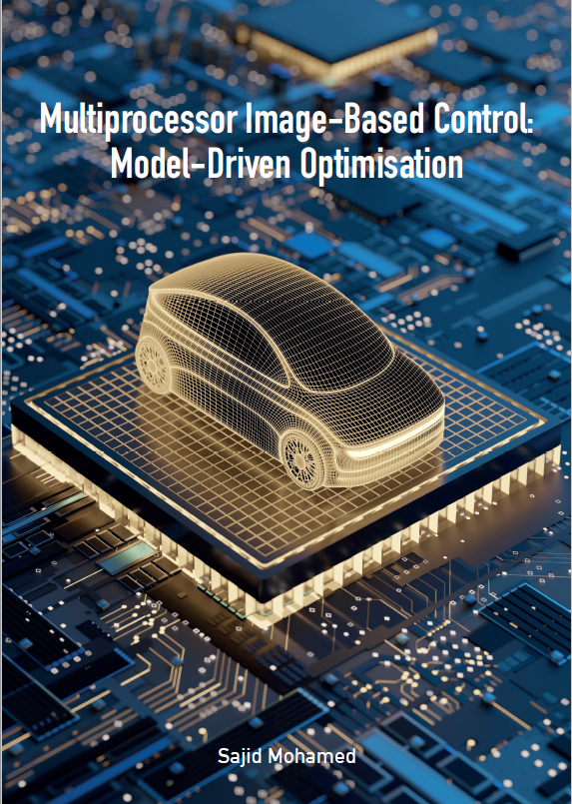
Multiprocessor Image-Based Control: Model-Driven Optimisation
Sajid Mohamed
Notes:
Hooggeleerde promotor, bedankt voor uw vraag. Highly learned members of the committee, family, friends and colleagues present here and also online, it is my pleasure to welcome you all to my public defense, and I sincerely thank you all for attending.

Slide 2
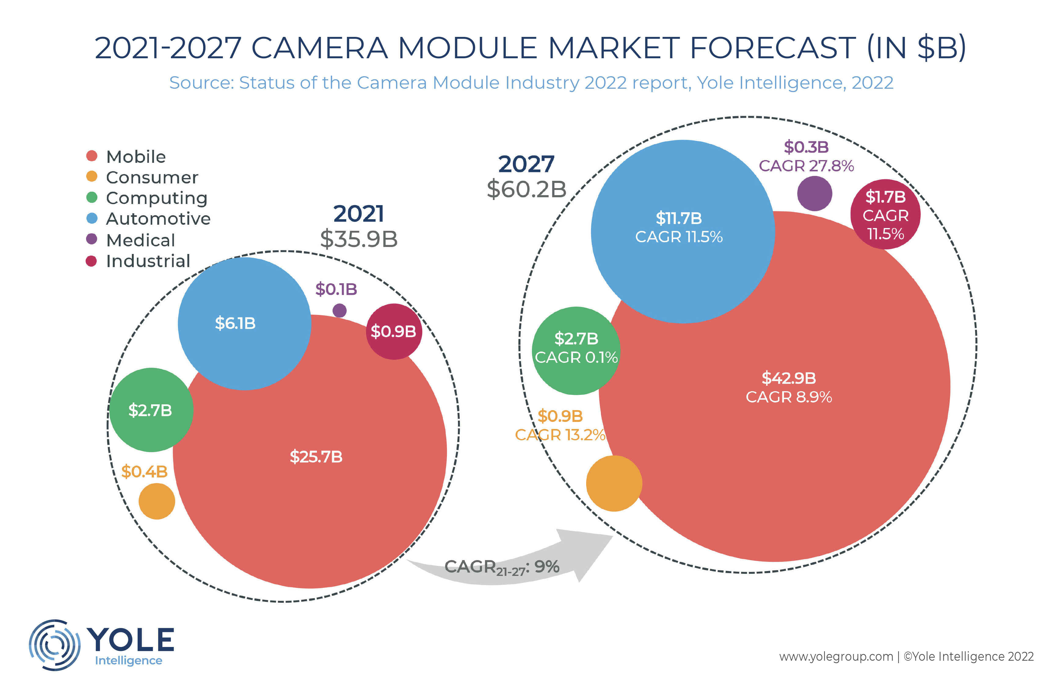
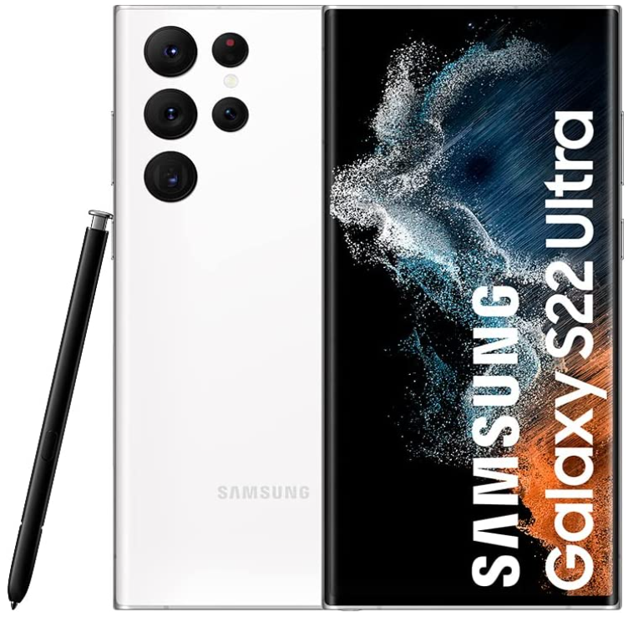
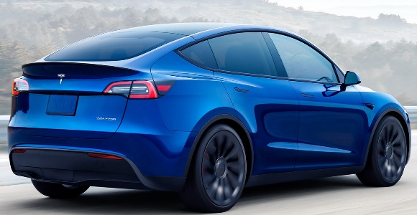
Cameras are and will be prominent
Notes:
Cameras are and will become more prominent in the mobile, automotive, medical and industrial domains in the future.
Did you know that Yole expects the camera module market to almost double to 60 billion by 2027?

Slide 3
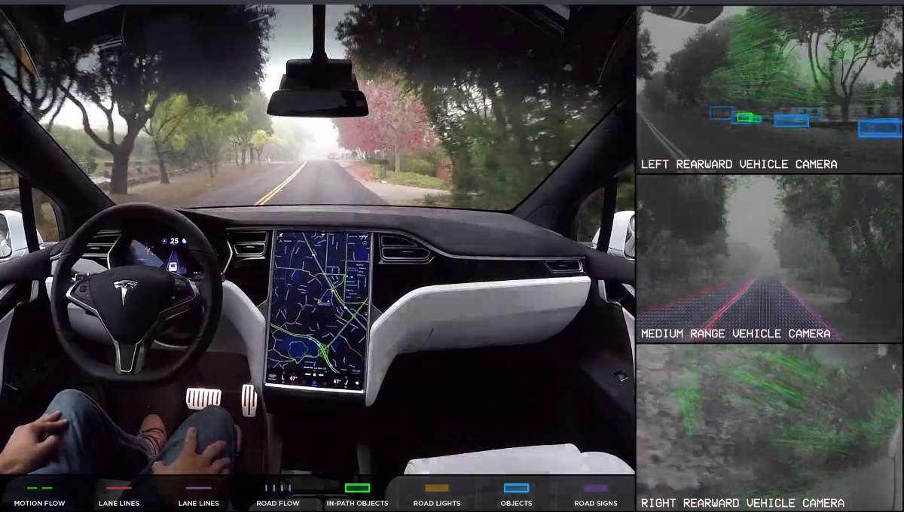
Tesla’s Autopilot
8 cameras
Full Self-Driving computer
5 cameras
~2.5GHz octa-core CPU
Notes:
Today, the Samsung Galaxy S22 ultra has 5 cameras, and the Tesla Autopilot has 8 cameras.
The adoption of cameras will only increase in the future.

Slide 4
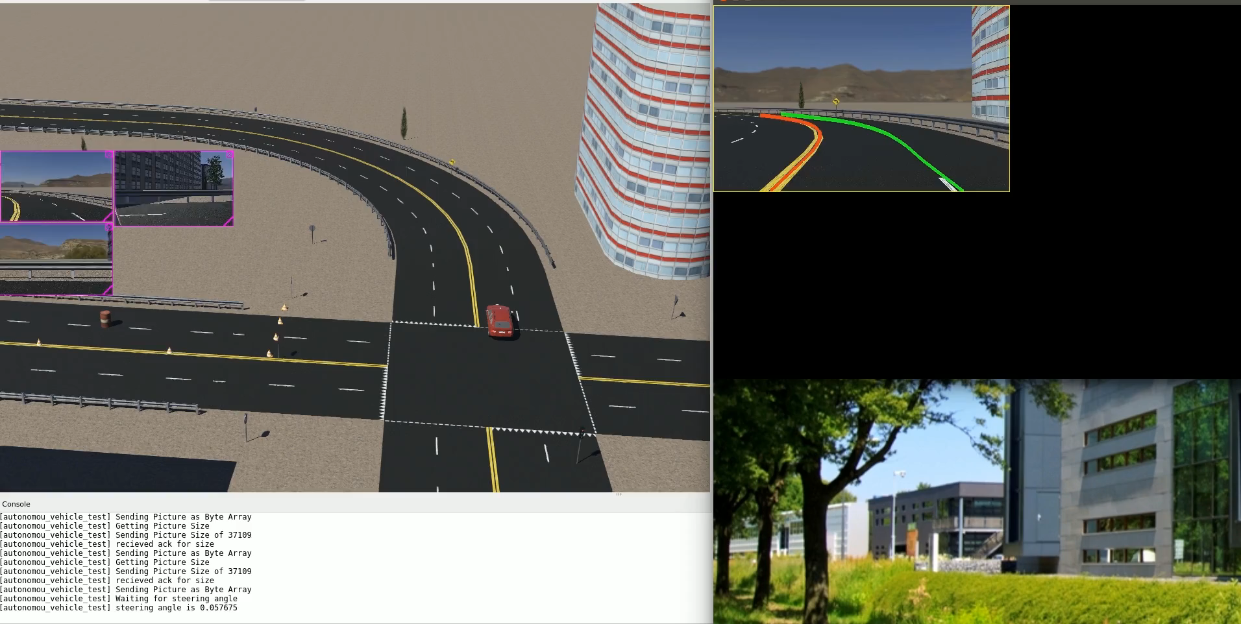
Image-Based Control (IBC)
Lane-keeping assist system
Notes:
Now, let us look at a type of camera-based system called the image-based control system. An example is the lane-keeping assist system. It is a camera-based system that tries to keep your car within a lane.

Slide 5



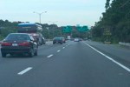
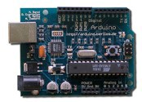





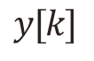
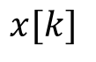
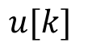
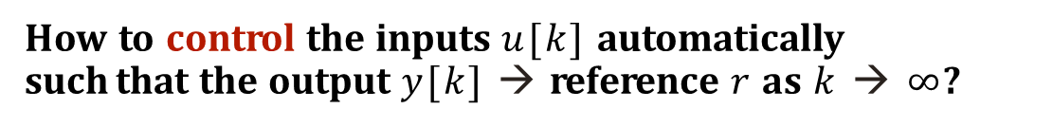
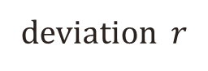
Multiprocessor Image-Based Control (IBC)
Lane-keeping assist system
vehicle on road
Multiprocessor platform
disturbance
steering angle
desired lateral
Control Strategies
lateral deviation
deviation $r$
C: Control
$$u[k]$$
A: Actuate
$$y[k]$$
$$x[k]$$
measure states
S: Sensing & processing
How to control the inputs $u[k]$ automatically such that the output $y[k]$ → reference $r$ as $k$ → $∞$?
Control objective
Notes:
Image-based control systems is a class of data-intensive feedback control system whose feedback is given by camera sensors.
I call this multiprocessor image-based control simply because the control strategies are executed in a multiprocessor platform.
The control objective for the lane-keeping assist system is to control the steering angle automatically to stay in the centre of the lane. You can also notice three prominent tasks- the image sensing and processing, control and actuate tasks.

Slide 6
Image-Based Control Sequential Implementation
Dropped frames
f_{h}
frame arrival period f_{h}
period
delay
P₁
time
Notes:
In a timing diagram, these three tasks can be mapped to a single processor as shown here. In an IBC implementation, the camera input arrives periodically with period fh.
The image sensing task S takes a long processing time. The period h is the period between two consecutive processing of the image frames. And the frames arriving within h are dropped. The delay is the time from frame arrival to end of actuation.

Slide 7
How to improve the IBC system performance?
Dropped frames
f_{h}
frame arrival period f_{h}
period
delay
P₁
time
IBC system Performance
Delay
Period
Notes:
How to improve the system performance of an image-based control system?
We can do this by reducing the delay and period.

Slide 8
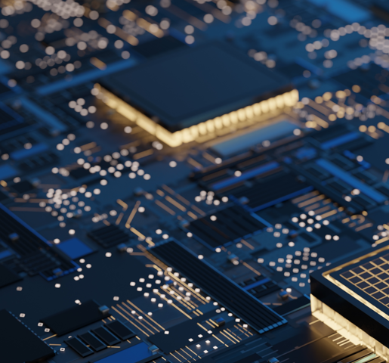
Image processing platforms nowadays mostly use multiprocessors How to utilise the given platforms efficiently to improve system performance?
Notes:
Image processing platforms nowadays most use multiprocessors.
One of the questions I explore in my thesis is how to utilise the given platforms efficiently.

Slide 9
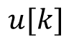
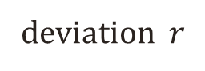
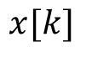
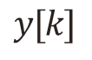
Multiprocessor Image-Based Control (IBC)
Lane changing system from a crazy developer
vehicle on road
Multiprocessor platform
disturbance
steering angle
desired
Control Strategies
lateral deviation
A: Actuate
deviation $r$
C: Control
$$u[k]$$
$$y[k]$$
$$x[k]$$
Count #vehicles
S: Sensing & processing
Notes:
Let us also look at another example of a lane CHANGING system. And this was done by a CRAZY developer.
The image processing task here involves counting the number of vehicles, and based on if it is high or low, the car changes the lane.

Slide 10
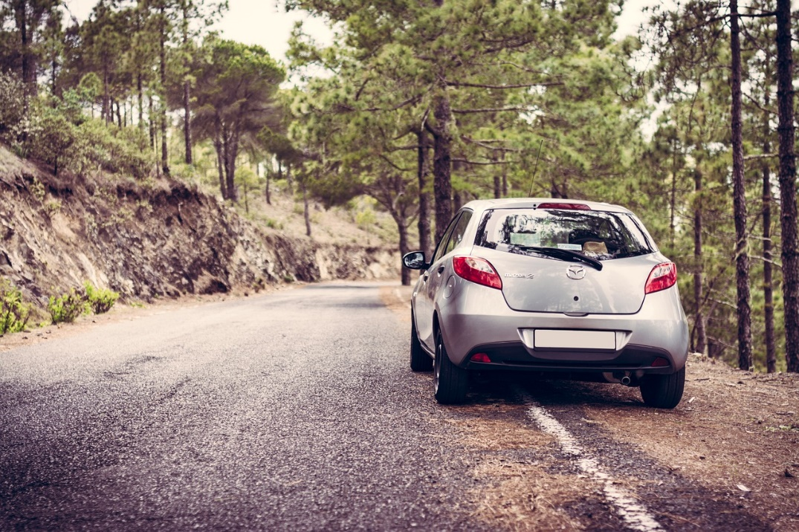
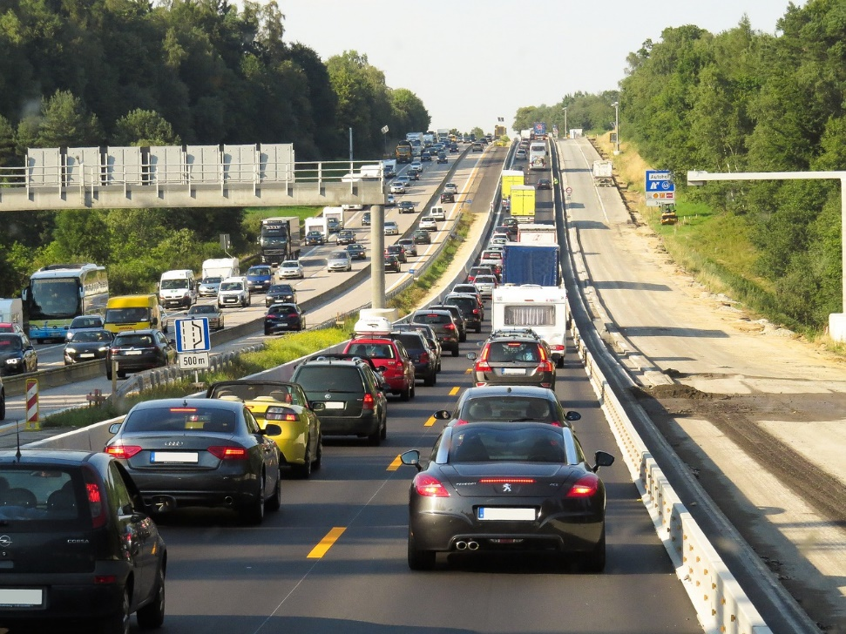

Image processing delay is variable and often long
t
t₂
time
Your task: Count the number of vehicles in the image
Notes:
Now, I have a task for you.
COUNT the number of vehicles in the image.
Done!
Now, count the number of vehicles in THIS image.
Just give it a try!
What do you observe? You could count for the first one instantly, but for the second image you need a long time.
So even for the same task, the image processing delay is variable and often long.

Slide 11
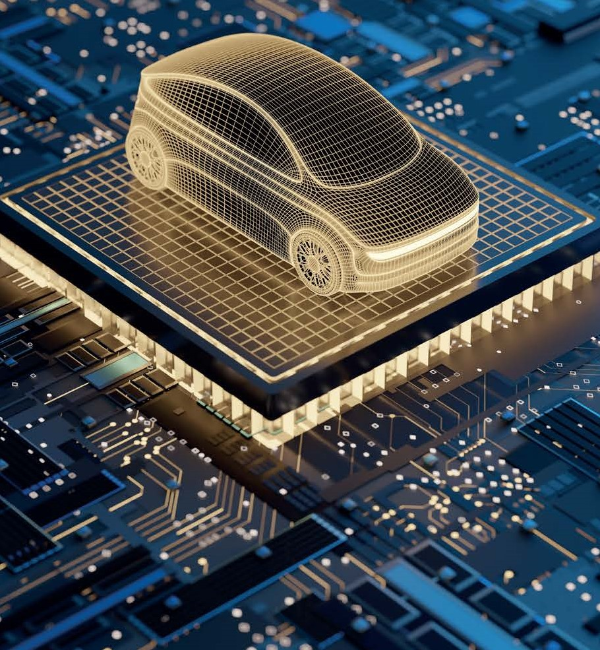
Image processing delay is application-specific How to effectively consider the application-specific characteristics?
Notes:
.So, the image processing delay is also application-specific.
Another question I try to address in my thesis is how to

Slide 12
The Problem
A long and variable delay in processing the image and getting a result
Research Question
How to cope with long variable sensing delay for a given platform allocation?
IBC system Performance
Delay
Period
Approach
Model-driven optimisation
considering platform-specific constraints and application-specific characteristics
Notes:
So, the problem I try to address is that there is a long and variable delay in processing the image.
The research question of my thesis is how to cope with this long variable sensing delay?
To solve this, I use a model-driven optimisation approach.

Slide 13

Contributions 1-3: A scenario- and platform-aware design (SPADe) flow
Sequential
P₁
Load
Count
C
A
period = delay = 4 f_{h}
30 fps
30 fps
period = delay = 3 f_{h}
period = 2 f_{h,} delay = 4 f_{h}
P₁
Count
P₁
Load
P₂
Count
C
A
P₂
Load
Count
C
A
Parallelisation
+
Pipelining
=
Pipelined
Parallelism
P₁
Load
Count
C
A
P₂
Count
P₃
Load
Count
C
A
P₄
Count
period = f_{h,}
delay = 3 f_{h}
P₅
Load
Count
C
A
P₆
Count
Notes:
We start with the sequential implementation when we have only one processor.
Now, let’s say we have two processors, then one thing we can do is pipelining. A pipe refers to one execution instance of a sequence.
In pipelining, we replicate the pipes on additional processing cores.
Another method we can use is parallelisation. The idea is that we parallelise the execution of possible subtasks.
E.g. in the counting the number of vehicles, we can split the image in two and count each part separately.
The third method we can use is the combination of pipelining and parallelism or pipelined parallelism. Here, a pipe is the parallel execution on two cores. The pipe can be replicated as many times as the available number of frames.

Slide 14
Contributions 1-3: A scenario- and platform-aware design (SPADe) flow
Optimise scheduling using model transformations
#pipes = 3
#parallel cores per pipe = 2
Parallelisation
+
Pipelining
= Pipelined
Parallelism
P₁
Load
Count
C
A
P₂
Count
P₃
Load
Count
C
A
P₄
Count
P₅
Load
Count
C
A
P₆
Count
Notes:
The scheduling can also be optimised using model transformations.
Any guesses for who the crazy developer of this application was?

Slide 15
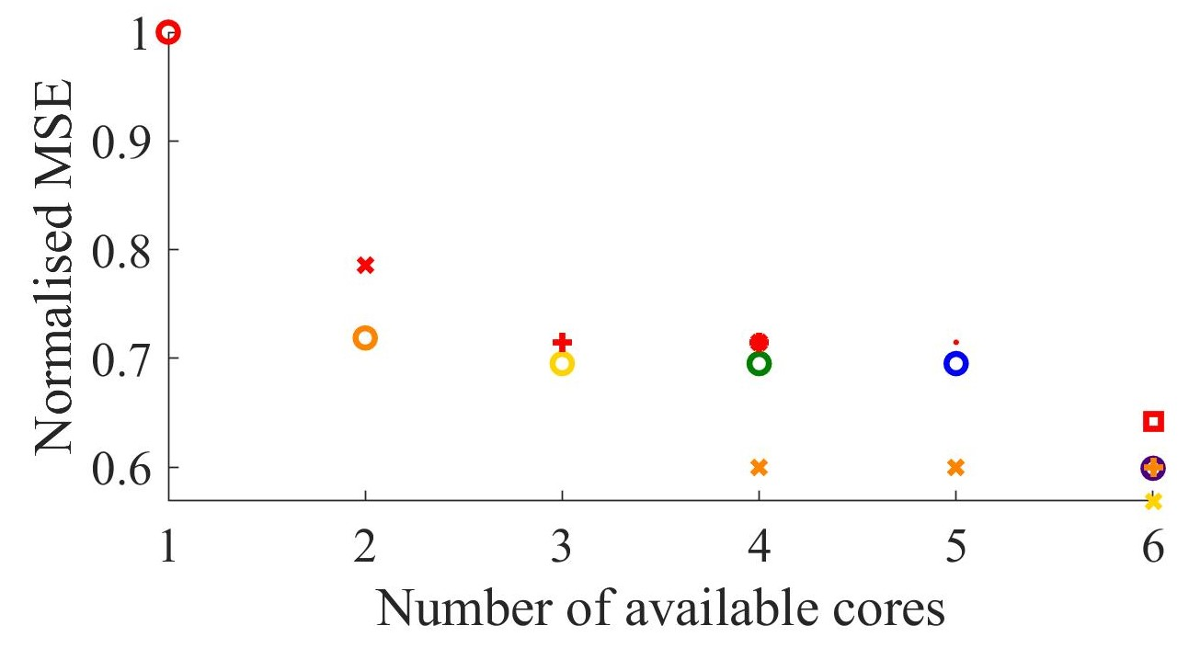
Contributions 1-3: Results
sequential
Lower MSE is better
Symbol - #pipes
Colour - #parallel cores per pipe
pipelined
parallel
Pipelined parallelism
Notes:
Now, the question is what do we gain by doing this.
This is a plot of normalised mean-square error vs the number of available cores for our application.
The MSE evaluates the IBC system performance, the lower MSE is better.
The symbols here refer to the number of pipes and the colour to the #parallel cores per pipe.
For the sequential implementation, both are 1. The red colour here means that there is no parallelisation. And the circles mean that there is no pipelining.
All other points are for pipelined parallelism.
For this particular application, you can see that already with parallel execution in two cores, we gain a significant improvement and if we have more cores available, we can gain even more with pipelined parallelism.

Slide 16


Contribution 4: Design considering image workload variations
S₁
S₂
S₃
sampling periods and delays for Markov states
system model
Discrete-time Markov chain
t
t₂
time
Markovian Jump-linear System Formulation
switching control system
Notes:
The fourth contribution is considering application-specific aspect called the image workload variations.
We can say that if the number of cars in the image increases, the image workload increases.
In my thesis, I propose a Markovian jump linear system formulation for considering the image workload variations.

Slide 17
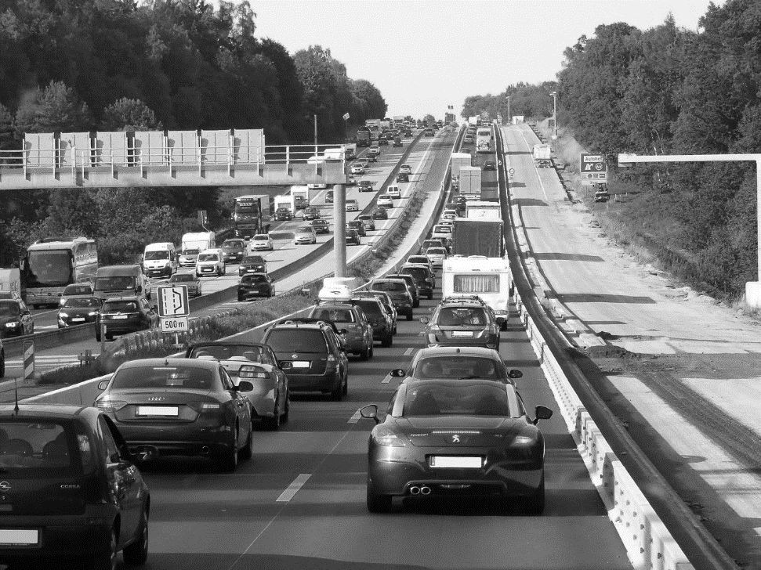
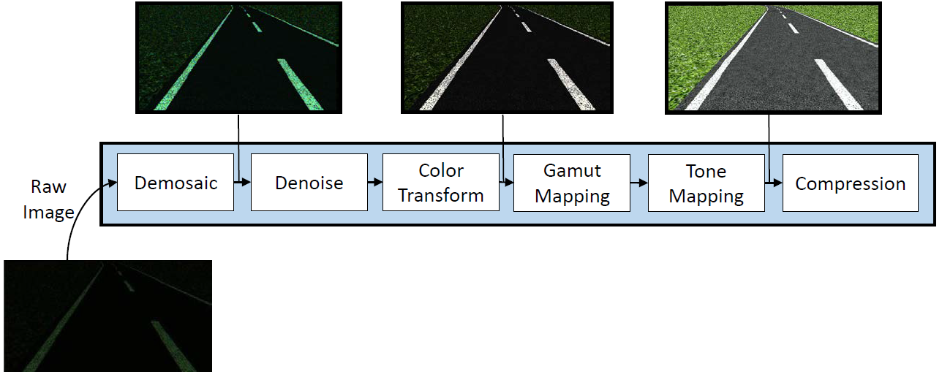
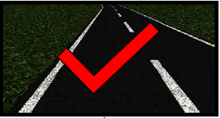
Contribution 5: Approximation-aware design
Trades off accuracy for time
Up to 44% improvement in IBC system performance compared to accurate implementation
Notes:
Can you still count the number of vehicles in this image?
This is an approximated image that skips some steps in the processing to reduce processing delay.
By skipping the steps, we trade-off accuracy in image processing for time.
We can do this also for lane-keeping assist system. The sequence of steps show an Image Signal Preprocessing pipeline.
By approximation, we can skip some stages and use the resulting image.
In my thesis we show upto 44% improvement in IBC system performance compared to accurate implementation.

Slide 18
This thesis: Efficiently uses the given platform and application characteristics to maximise the image-based control performance
Notes:
So, the advantage

Slide 19





Summary: Contributions
How to cope with long variable sensing delay of an IBC system for a given platform allocation?
Platform-specific
Application-specific
SPADe flow for IBC system design considering parallelisation
S. Mohamed, et al., MICPRO 2020.
S. Mohamed, et al., DSD 2018.
IBC system design considering workload variation
S. Mohamed, et al., CDC 2019.
Extending the SPADe flow considering pipelining for IBC system design
S. Mohamed, et al., CDC 2020.
Approximation-aware IBC system design
S. Mohamed, et al., MECO 2019.
S. De, S. Mohamed, et al., IEEE Access 2020.
S. De, S. Mohamed, et al., DATE 2020.
Extending the SPADe flow considering pipelined parallelism for IBC system design
S. Mohamed, et al., IEEE Access 2021.
Delay
Period
IBC system Performance
Notes:
So, the advantage

